Slide 1

created data4data June 2023

Slide 2

created data4data June 2023

Slide 3
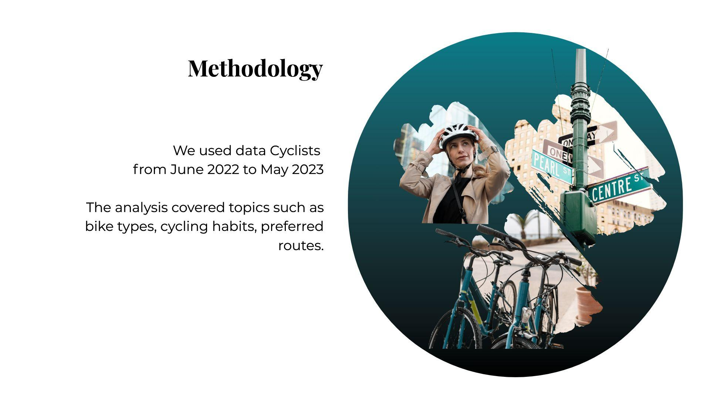
created data4data June 2023

Slide 4
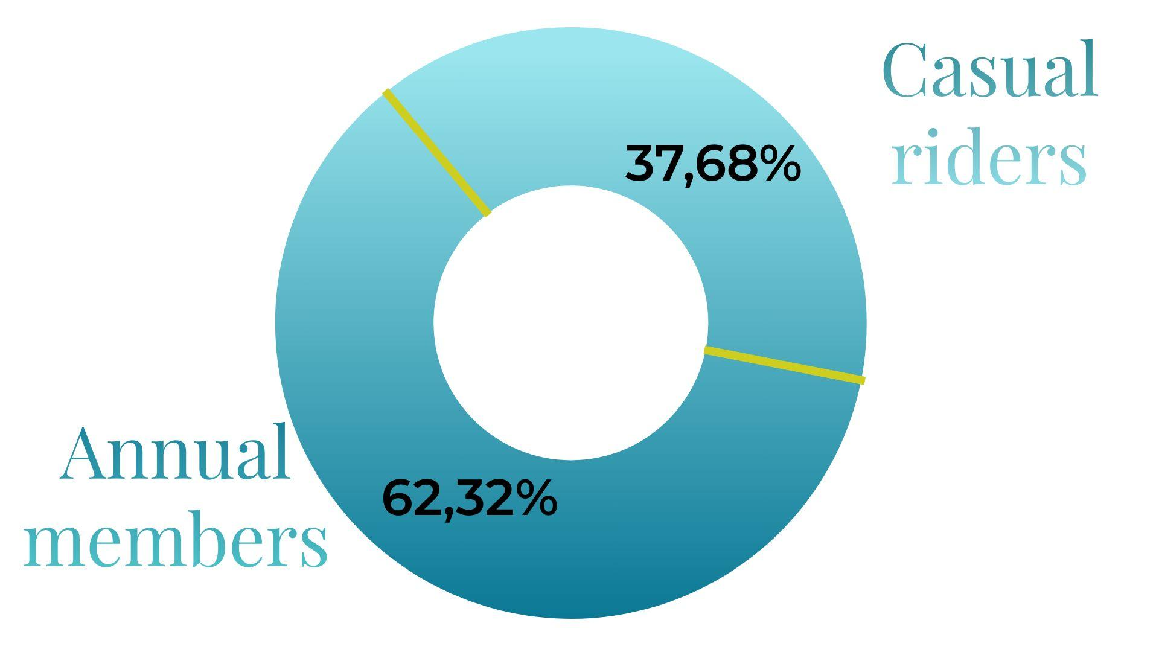
created data4data June 2023

Slide 5
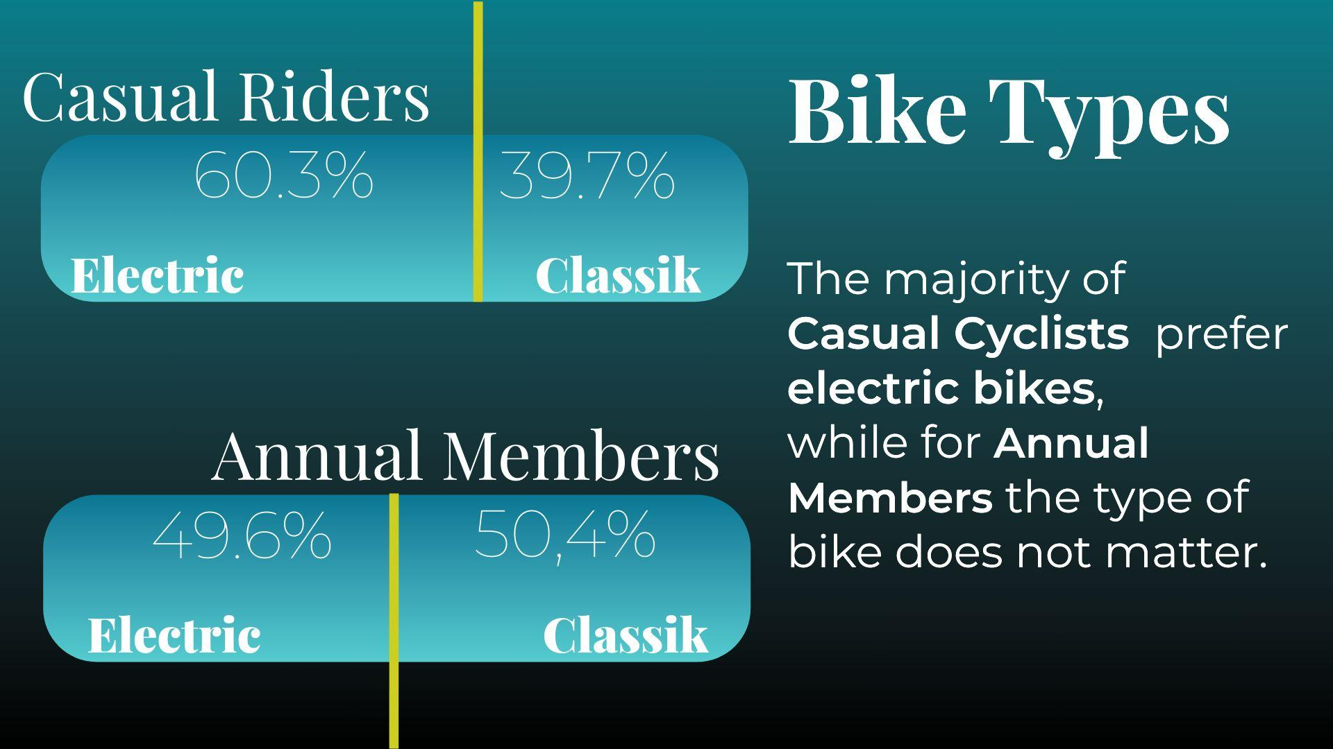
created data4data June 2023

Slide 6

created data4data June 2023

Slide 7
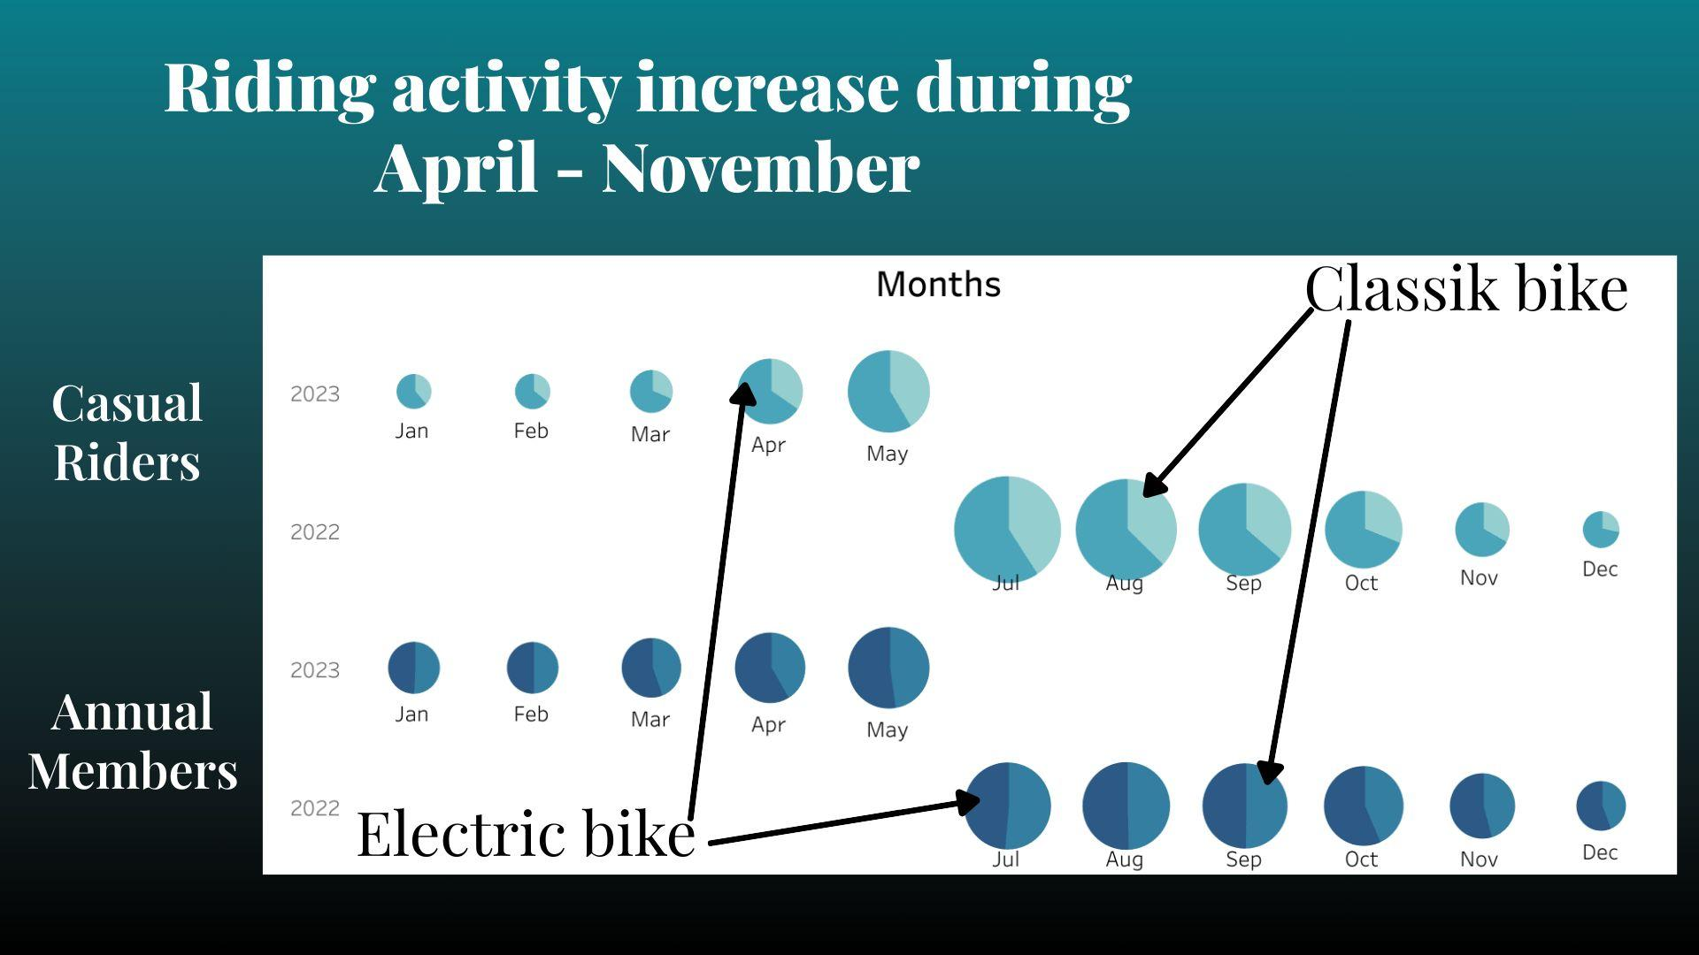
created data4data June 2023

Slide 8
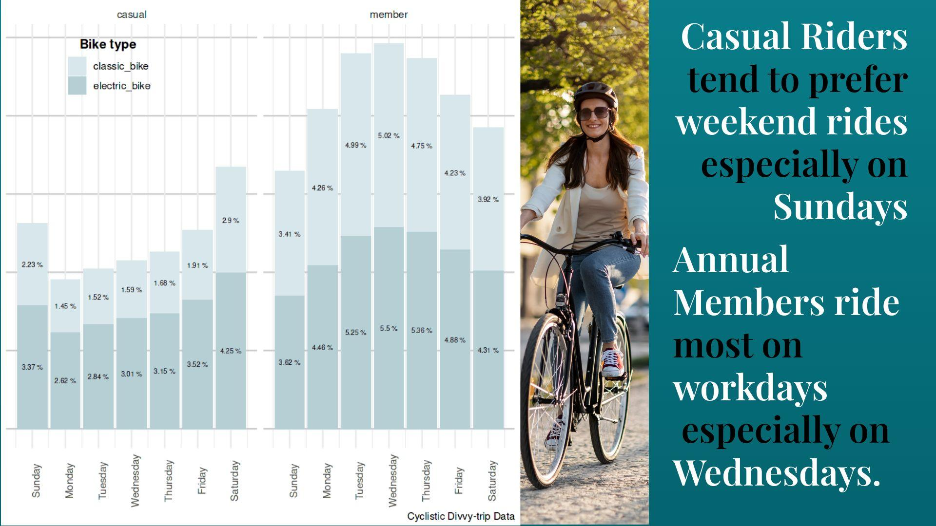
created data4data June 2023

Slide 9
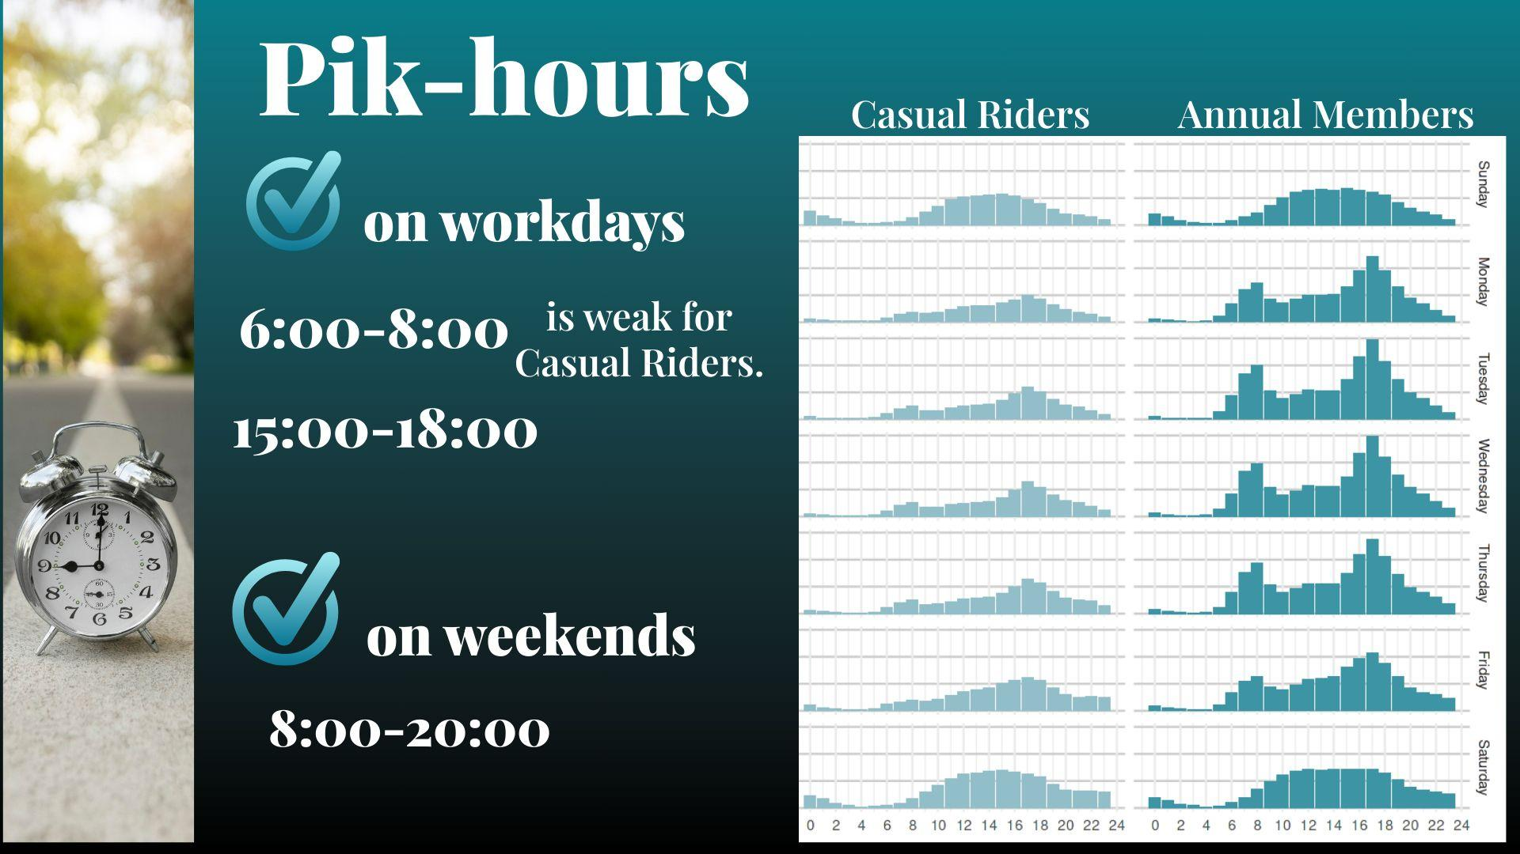
created data4data June 2023

Slide 10
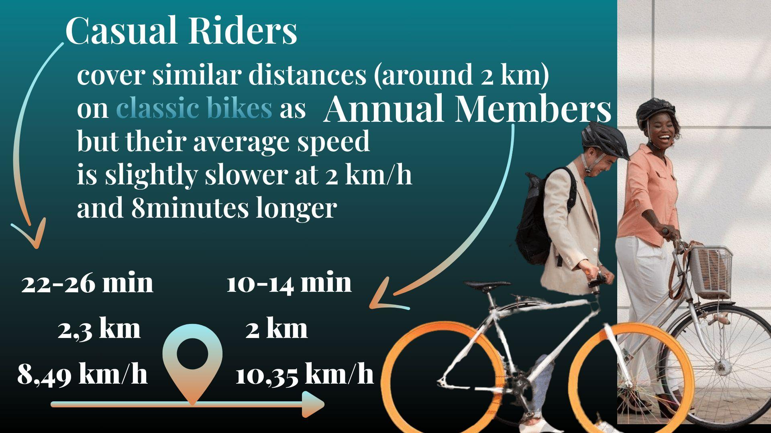
created data4data June 2023

Slide 11
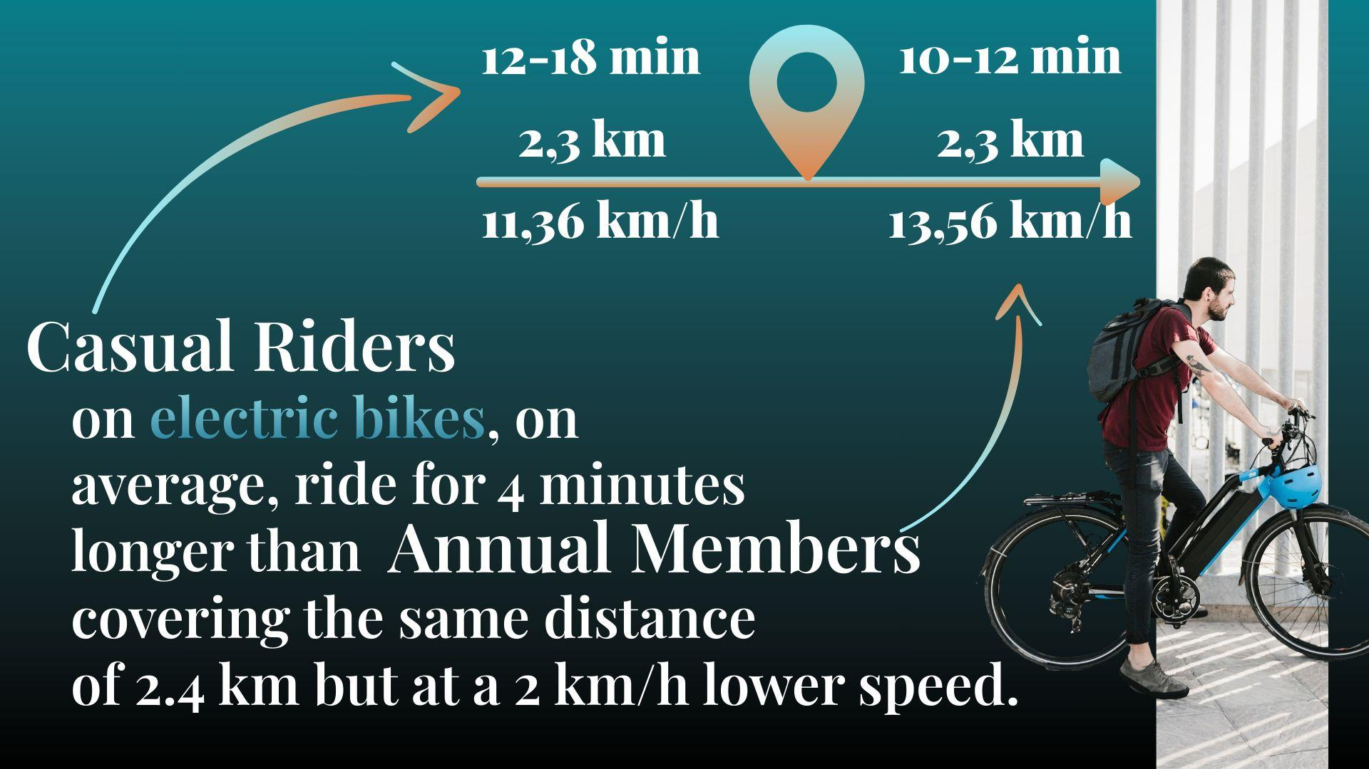
created data4data June 2023

Slide 12

created data4data June 2023

Slide 13
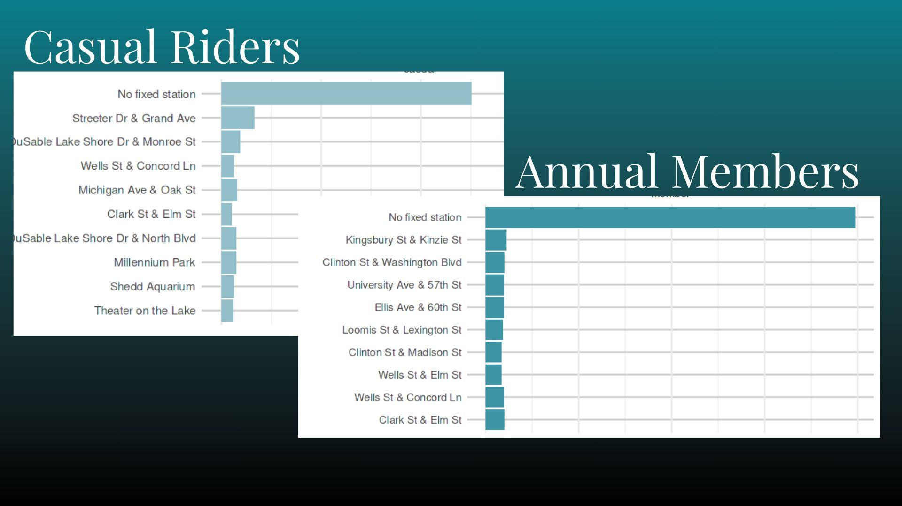
created data4data June 2023

Slide 14
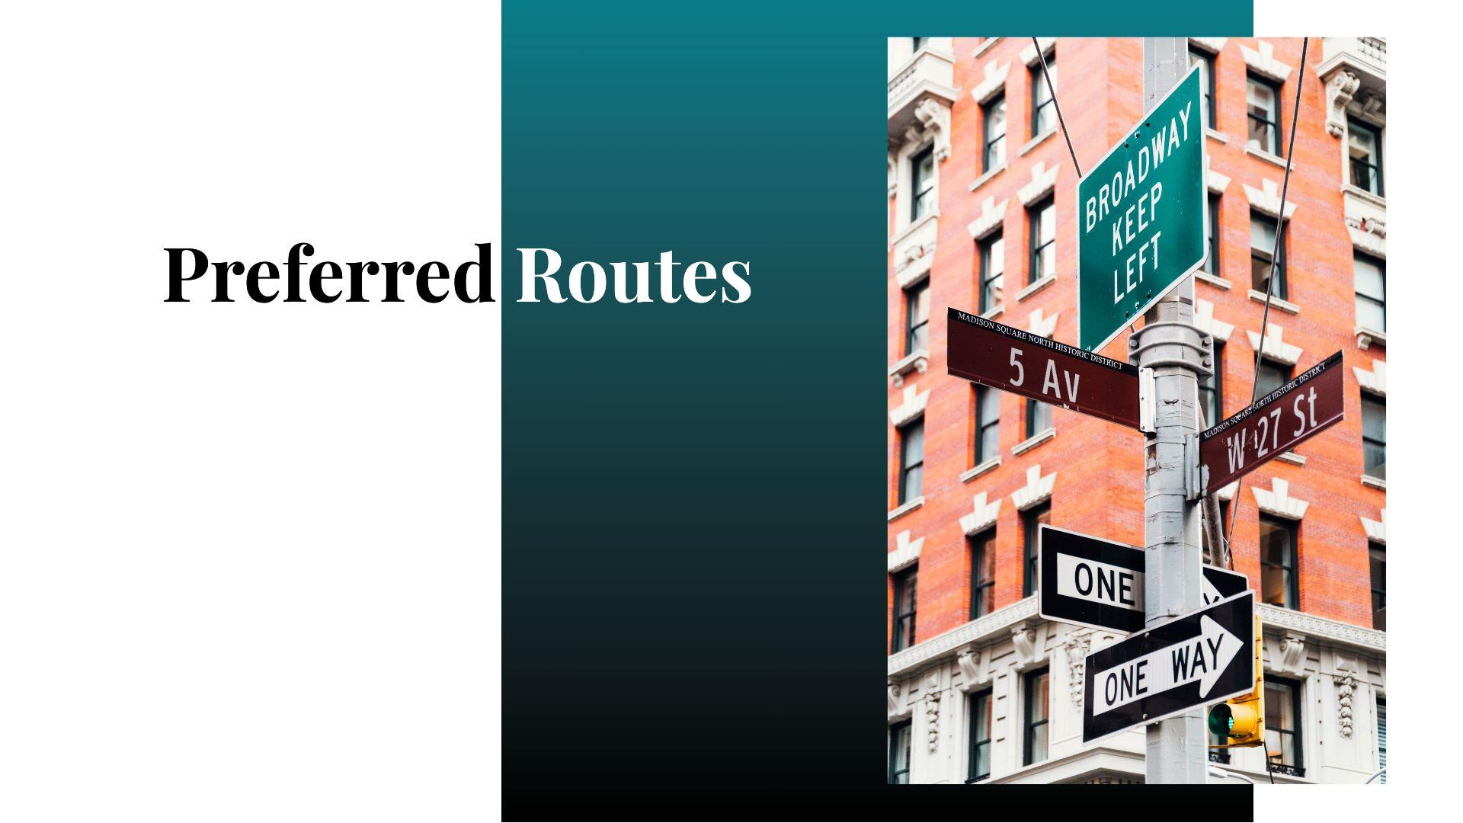
created data4data June 2023

Slide 15
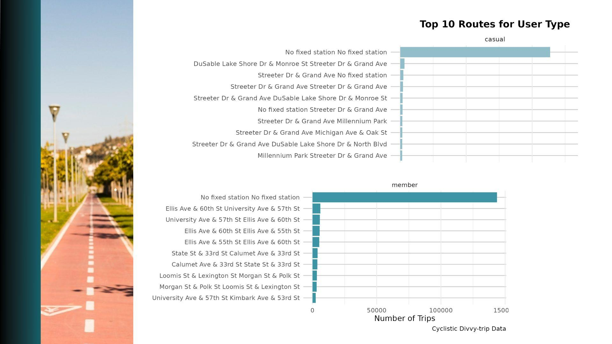
created data4data June 2023

Slide 16
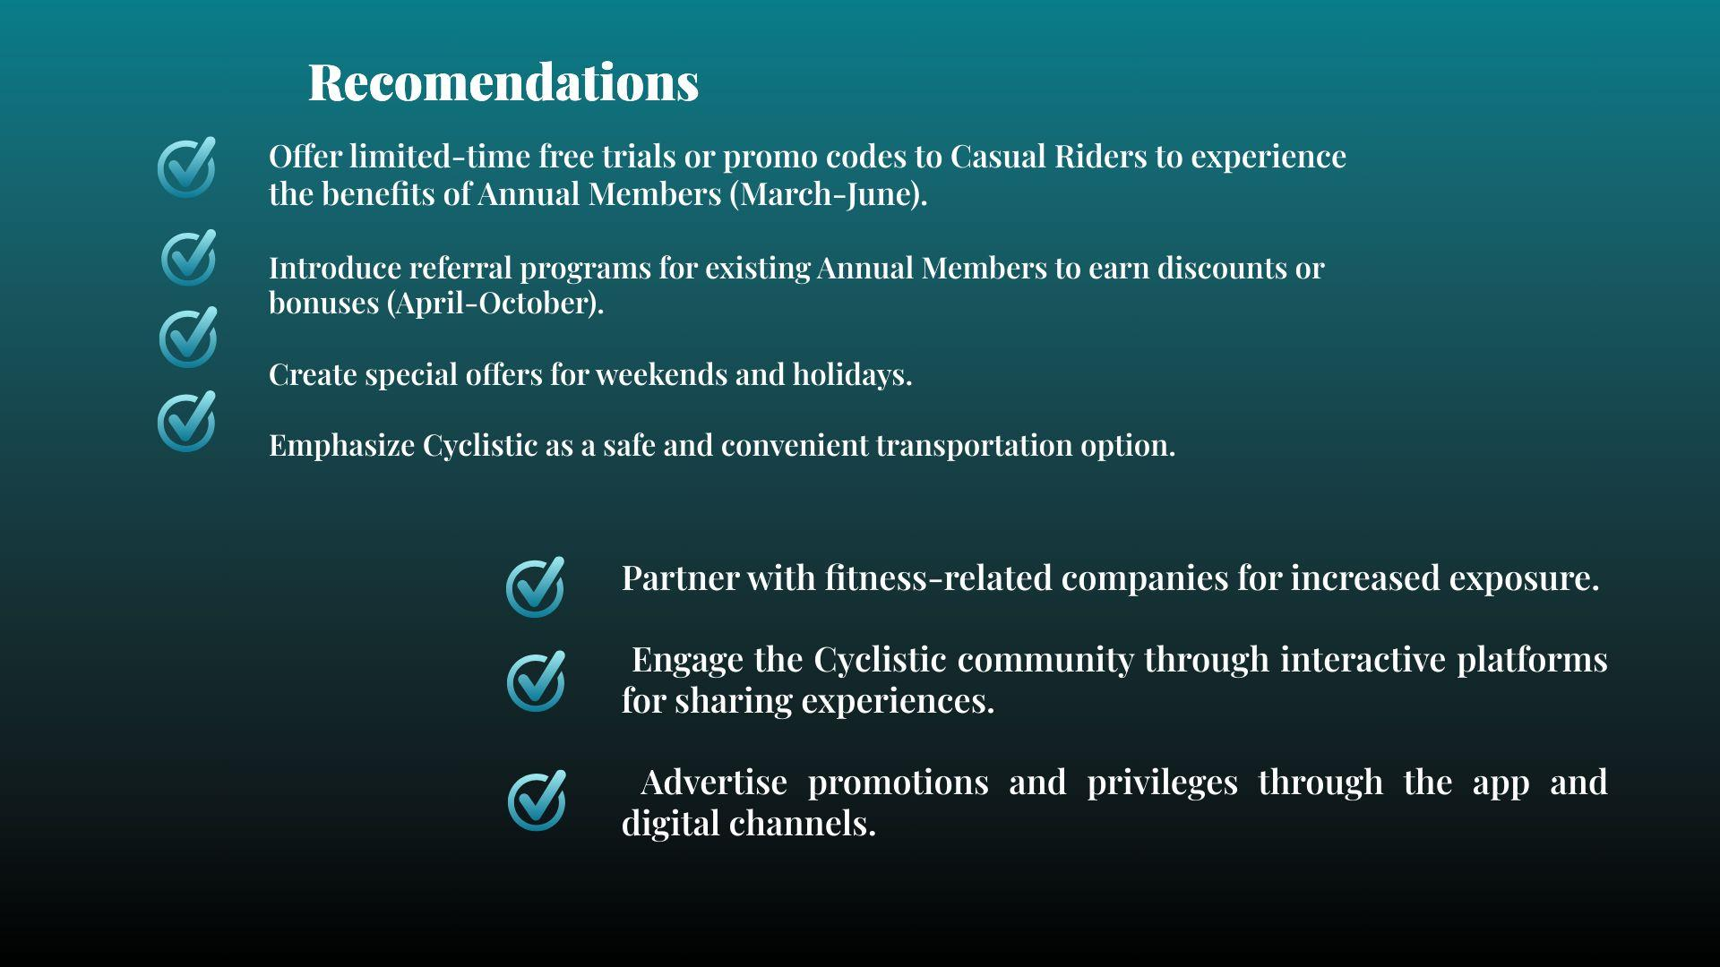
created data4data June 2023
Notes:
Casual riders are not much different from annual members, so all the marketing that works should remain, but it is worth paying attention to such points as... And also consider the possibilities of ....

Slide 17

linkedin
github
kaggle
created data4data June 2023

Slide 18


